Slide 1
Deep Reinforcement Learning
For
Automated Vehicles
Sagar Nandeshwar
Student ID: 260920948

Slide 2
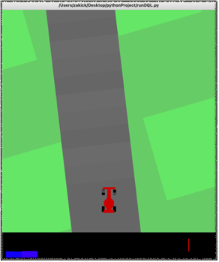
Project Overview
I build an autonomous vehicle using two deep reinforcement learning algorithm for OpenAI Gym CarRacing-v0 environment and and compare their performance in terms for rewards and training time .
I have Implemented
Deep Q learning
Double Deep Q learning

Slide 3
Motivation
I have always been very passionate about cars (but mostly vintage cars)
I believe the automated transportation (group or individual) is going to be our future. Numerous benefits - Reduce traffic, Reduce Accidents, and stress
However, from all the courses (COMP 551, COMP 585, COMP 579 COMP 424) and experience, I know developing such technology is very challenging. Complex Algorithms, Huge Dataset, Uncertain Environment etc.
I tried to implemented two such algorithm to learn and understand the complexity behind such technology.

Slide 4
Q leanring
Q-learning is a way for an agent to learn how to make decisions based on feedback it receives from its environment. The Q-learning algorithm works by maintaining a table of values for each state-action pair, called the Q-table. The values in the Q-table represent the expected future reward that the agent can receive by taking a particular action in a particular state. The agent uses the Q-table to determine which action to take in each state.

Slide 5
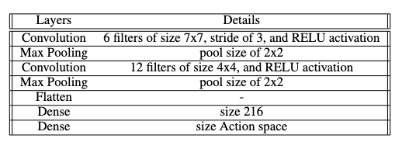
Deep Q Learning
Deep Q-learning is a variant of Q-learning that uses a deep neural network as a function approximator to learn the Q-function. In traditional Q-learning, the Q-values are stored in a table, which becomes infeasible for large state-action spaces.
In deep Q-learning, a deep neural network is used to estimate the Q-values for each state-action pair. The neural network takes the state as input and outputs a Q-value for each possible action. The neural network is trained using the Q-learning algorithm, where the target Q-value is computed using the Bellman equation and the experience replay technique is used to break the correlations between consecutive samples.

Slide 6
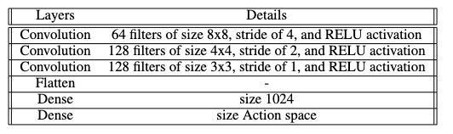
Double Deep Q Learning
Double Deep Q-Networks (DDQN) is a variant of deep Q-learning that addresses the problem of overestimation of Q-values that can occur in standard Q-learning and other Q-learning variants.
In standard Q-learning, the Q-values can be overestimated because the maximum Q-value for the next state is used in the update rule, which may not always be accurate, especially in noisy or complex environments.
DDQN uses a two network, called the target network, to estimate the target Q-values for the update rule. The target network is a copy of the main network, which is periodically updated to match the parameters of the main network.
The target network is used to estimate the Q-value for the next state and action, while the main network is used to select the action to take in the current state.
By decoupling the selection of the action from the estimation of the target Q-value, DDQN is less prone to overestimation of Q-values, which can lead to more stable and accurate learning

Slide 7
Training Process (Time)
It took almost 25 hours to train each models.
Took me almost two weeks to get some decent results.
However, I took this opportunity to show off my friends my powerful my laptop fans.
I sincerely apologies of disturbing library peace

Slide 8
Training Process (Processing Techniques)
Implemented Reply Technique
To stabilize the learning process and prevents the agent from overfitting to recent experiences, stores a collection of past experiences in a buffer and samples from it randomly to train the neural network.
Modified Environment Termination Policy:
According to the environment, the episode finishes when either all of the tiles are visited, or the car goes outside of the playfield in which case it will receive -100 reward. However, I also terminate the process if the car stays on field for more than the tolerance (i.e., 25 steps) .

Slide 9
Training Process (Processing Techniques)
Image processing:
Unlike colored images, where each pixel represents three RBG components (3 * 8 bits per pixel), in grayscale images the value of each pixel only represents an amount of light, i.e., it carries only intensity information (8 bits per pixel). In DQL, every three consecutive states are first stacked together and then converted int grey scale image. They are then turned into a 1-Dimention data array that is feeding into the model.
Discrete Action Space
In order to reduce the complexity, I reduce the action space into 12 desecrate actions that are combination of three direction (left, right and center), two speed (0 or full) and two breaks (0 or 0.2). I give an extra reward for full speed, in order for the car to find short cuts.

Slide 10
Training Process (Processing Techniques)
Mini-batch training
Periodically I sample a batch from the dataset and train the main model, after every 65 steps. For DDQL, I then trained the target model after every 10 episodes. For both methods, I saved the model after every 25 episodes
Decaying epsilon for Greedy Epsilon policy
I began the training that epsilon equals 1.0, i.e. total exploration, however slowly, I reduced the epsilon to 0.0 making it complete exploitation. During evaluation I set the epsilon to be 0.0.

Slide 11
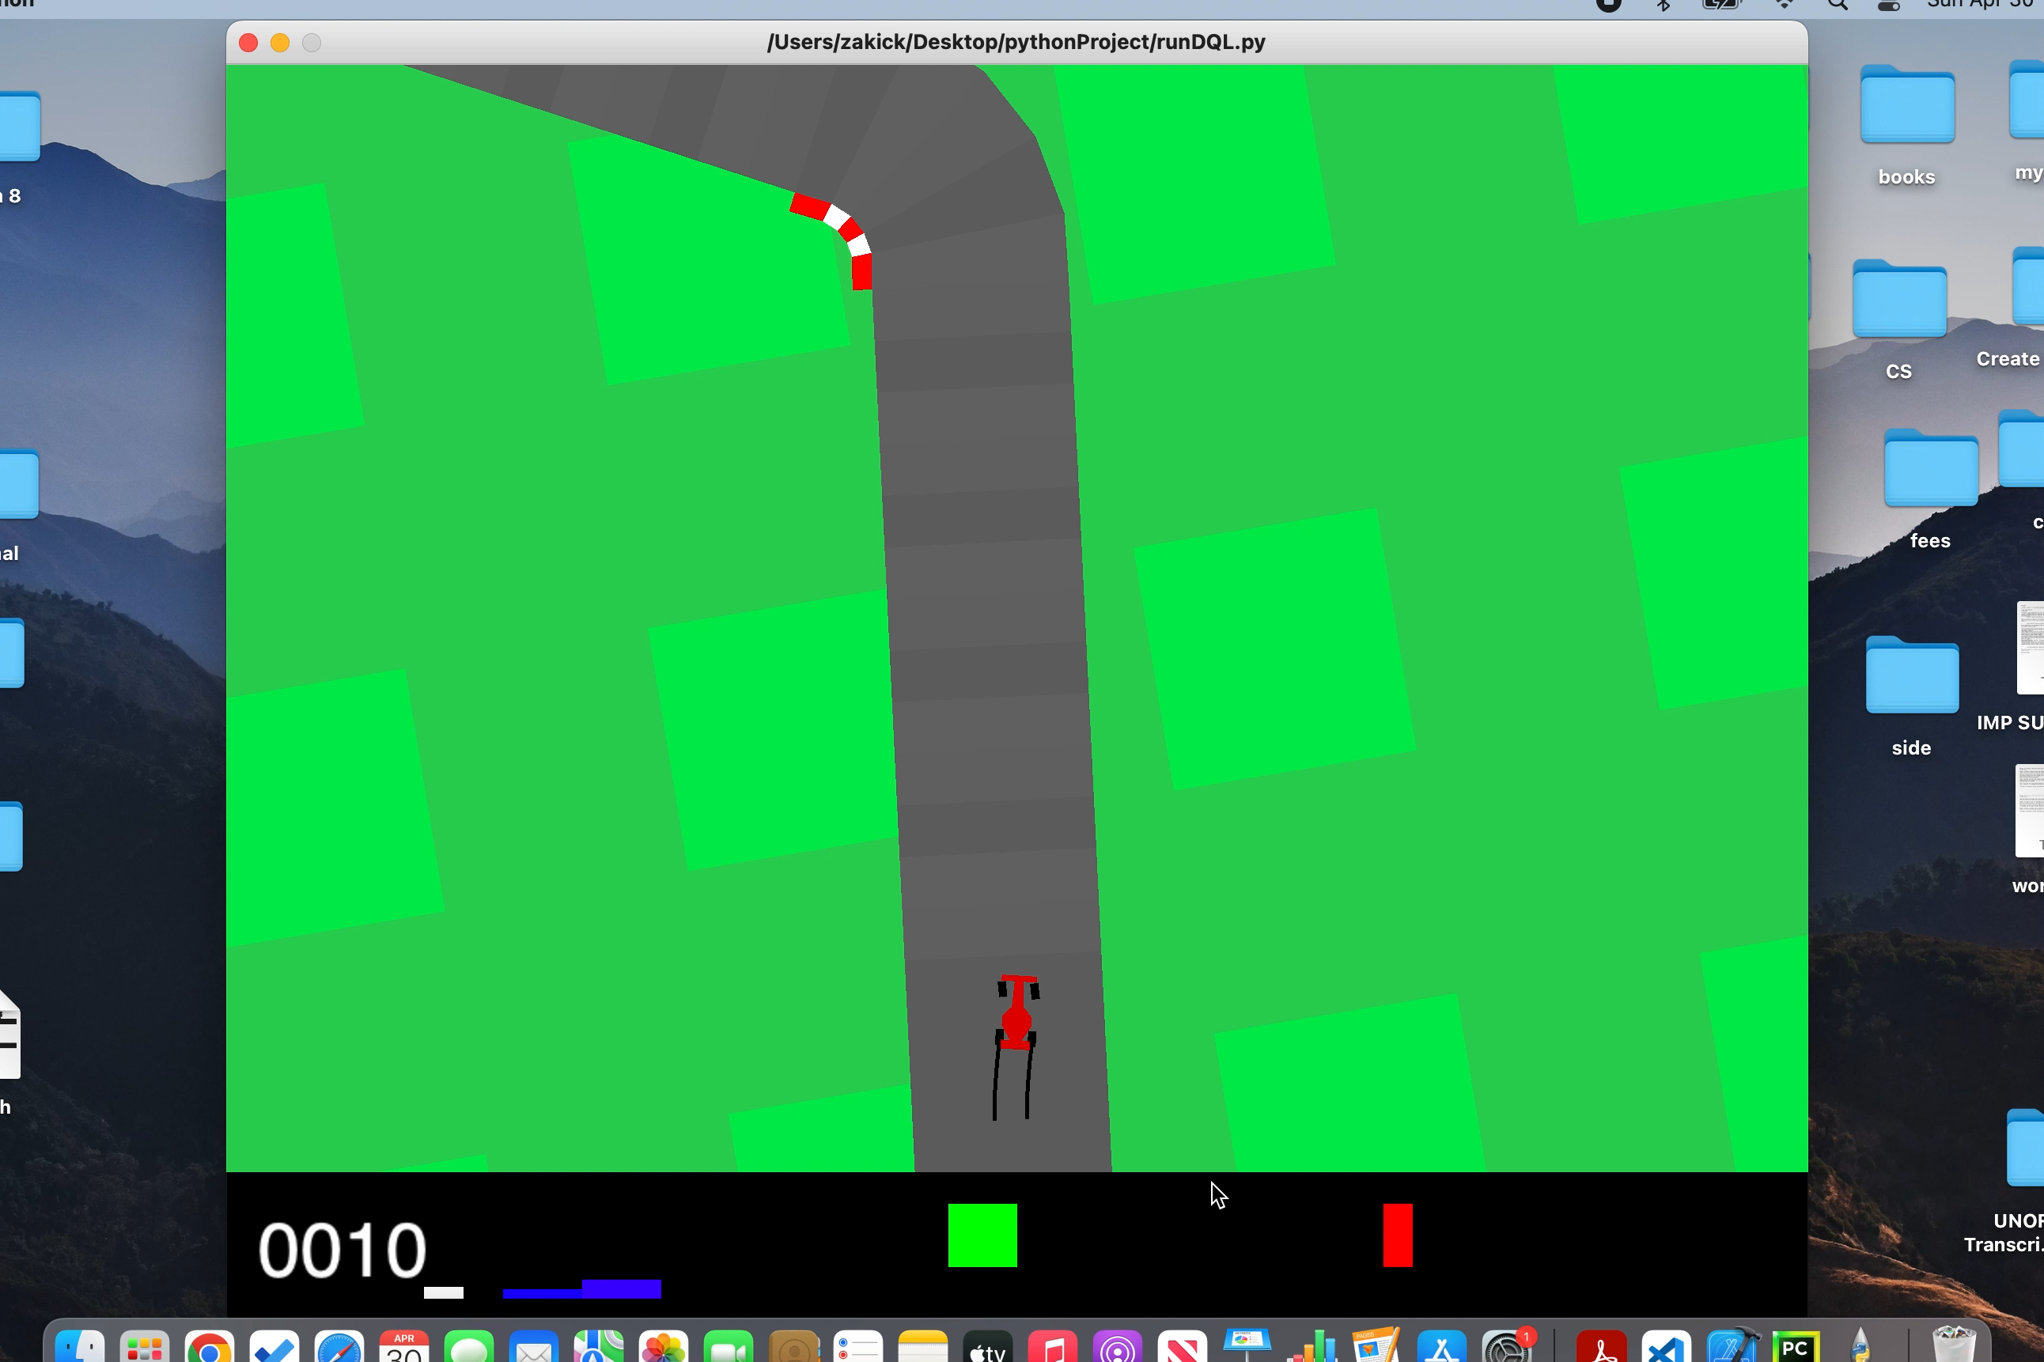
Result DQL

Slide 12
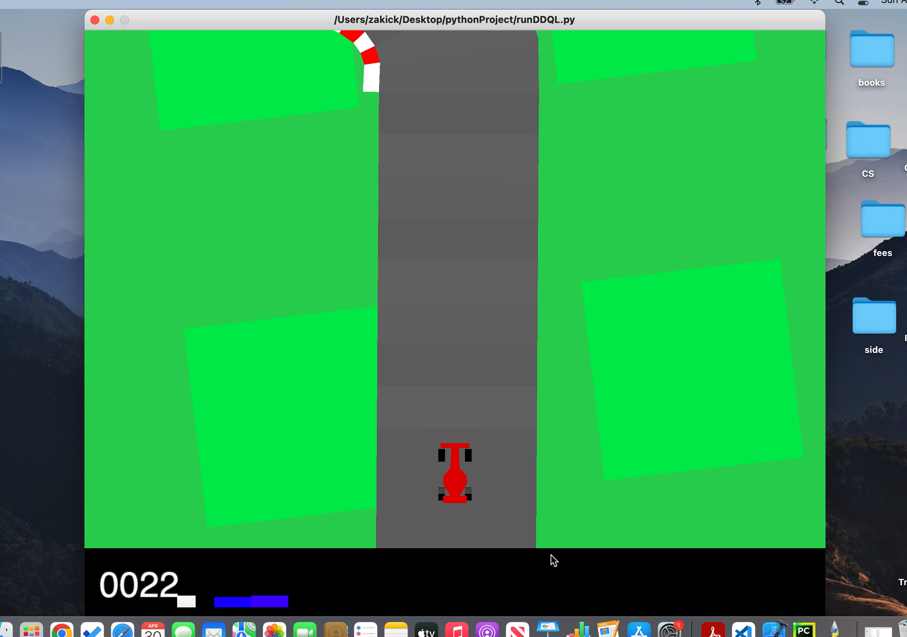
Result DDQL

Slide 13
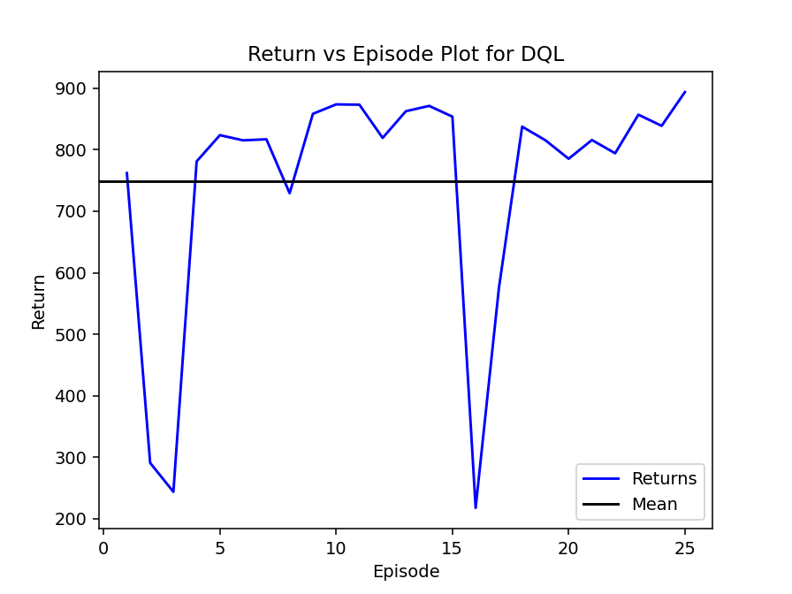
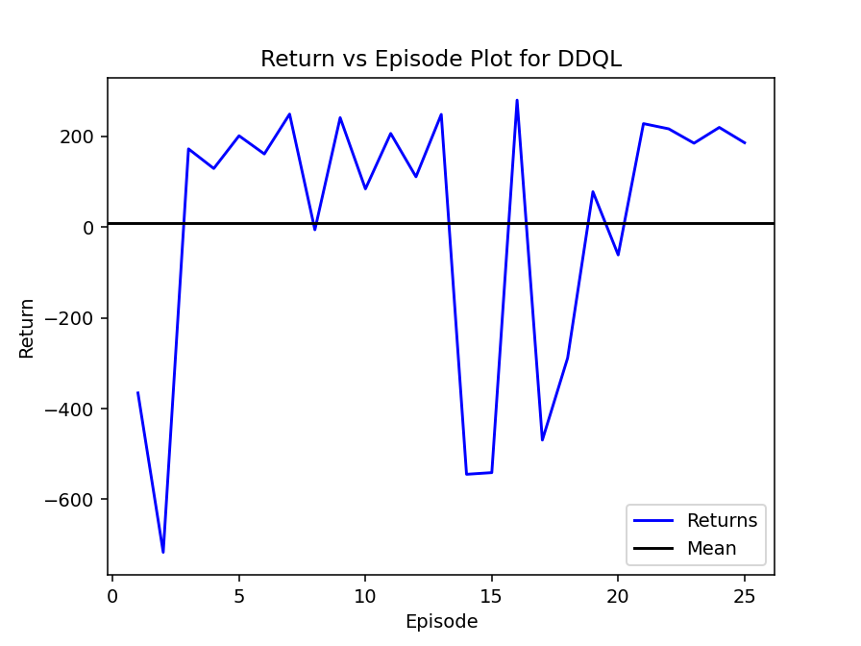
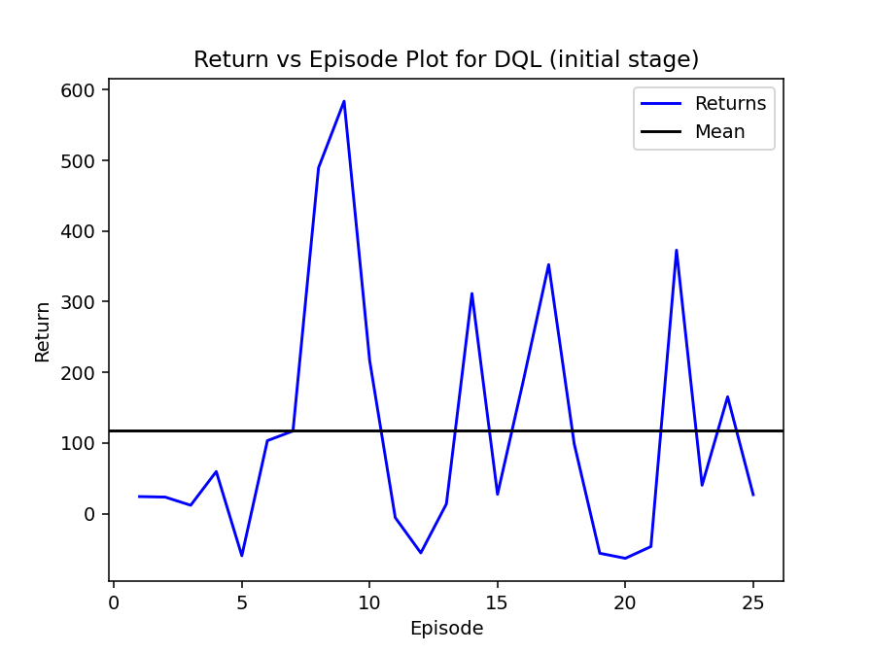
Rewards Plots

Slide 14
Conclusion
My DQL implementation has, evidently, outperformed the DDQL methods.
However, when I compare the early stage DQL with DDQL, their performance were quite similar.
This may indicate the DDQL need a much more resources to train or maybe I need to change hyper parameters such frame depth and exploration rate.

Slide 15
Future Work
The model might not give a very comfortable ride to the passenger if used in real life. For comfortable journeys, it is important that the model understands the dynamics of cars such as jerks etc. This issue may be resolved if we use continues action space with more control over motion.
Secondly, OpenAI is a relatively simple environment; the car is practically isolated. A model should be trained for much more complex and real-life scenarios, which may include other cars, obstacles, traffic rules etc.
Third, these models could be trained with a powerful GPU. This would give much more flexibility in terms of training processes and data manipulation.
Lastly, other reinforcement learning algorithms, such as PPO (Proximal Policy Optimization) and DDPG (Deep Deterministic Policy Gradient) could also be tested and evaluated for this environment.

Slide 16
Thank you

